Slide 1
Binary I/O

Slide 2
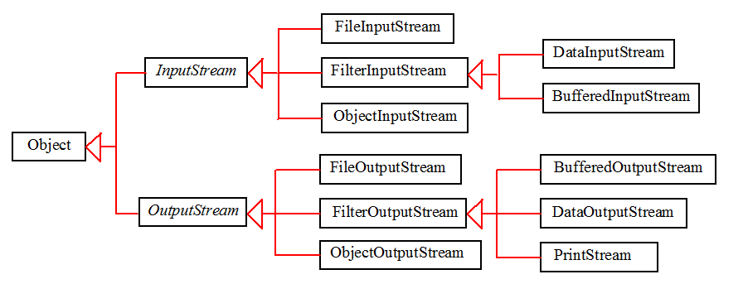
Binary I/O Classes

Slide 3
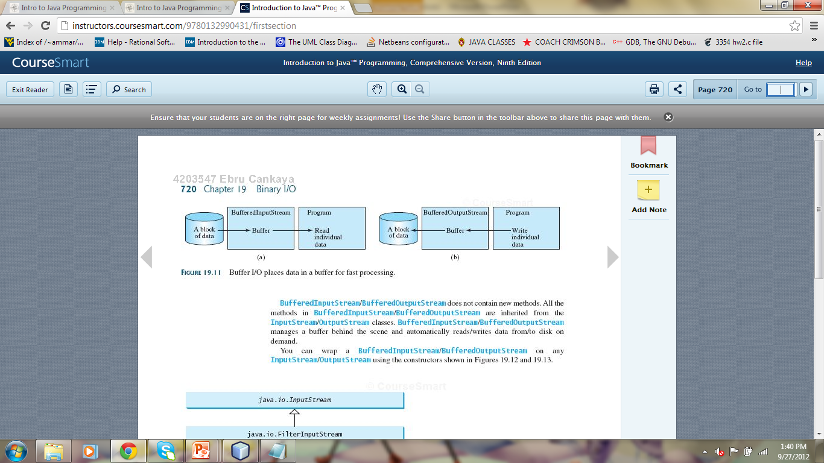
Buffered I/O

Slide 4
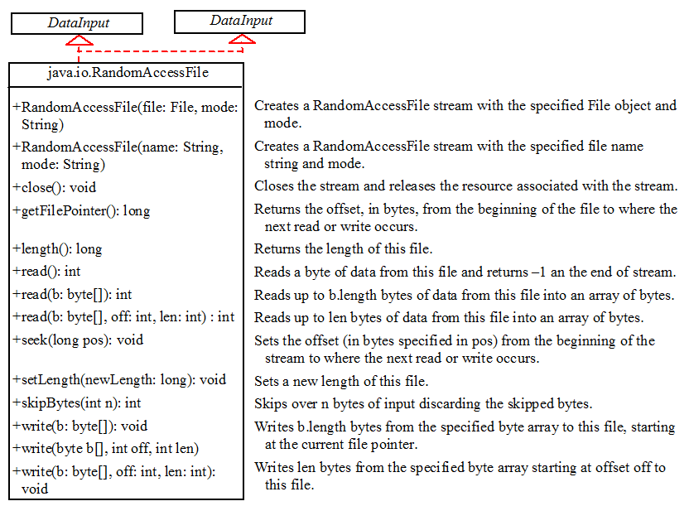
Random Access Files

Slide 5
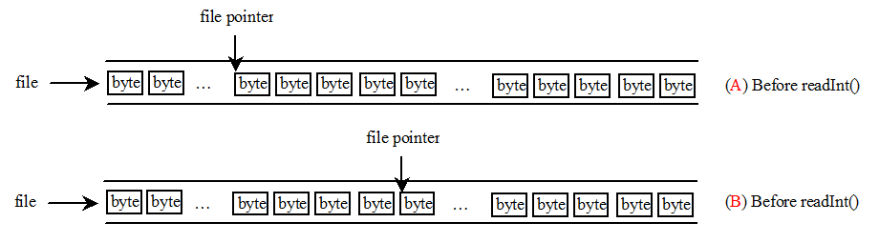
File Pointer
Is a special marker to keep track of bytes on a random access file consists of a sequence of bytes.
A R/W operation takes place at the location where the file pointer is.
When a file is opened, the file pointer sets at the beginning of the file. When you read or write data to the file, the file pointer moves forward to the next data.
E.g. a readInt() causes the JVM to read four bytes from the file pointer. Then the file pointer is advanced four bytes ahead.

